Slide 1
Terro’s Real Estate Agency Business Insights
Presented by
Palak Grover

Slide 2
STAR
Situation
We have a real - estate agency that wants to earn high-profit margin (commission) by understanding the correct market price of a property
Task
"To analyze and understand the key characteristics of the properties to get the correct estimation of its market price"

Slide 3
Action
1. To understand various parameters required to determine the price of houses
2. Perform the descriptive analysis of the related parameters
3. Perform regression to determine the avg price of houses
4. Determine the significant coefficients to predict the value of Y, i.e., the Average Price
Result
Give the insights that can help the Terro’s Real Estate Agency make profits in their business

Slide 4
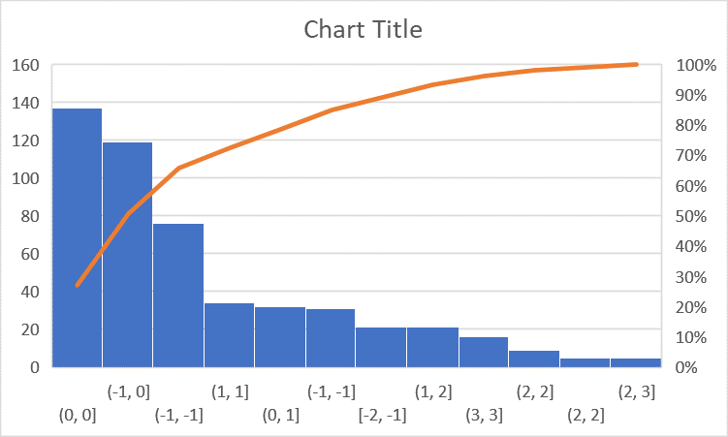
The histogram for the average price is left skewed, meaning, there is a sharp rise in price

Slide 5
Top 3 Positively Co-related Pairs
Pairs with Co-relation
Tax and Distance | 0.910228
NOX and Indus | 0.763651
NOX and Age | 0.73147

Slide 6
Top 3 Negatively Co-related Pairs
Pairs with Co-relation
Avg_Price and LSTAT | 0.73766
LSTAT and Avg_Room | 0.61381
Avg_Price and PTRatio | 0.50779

Slide 7
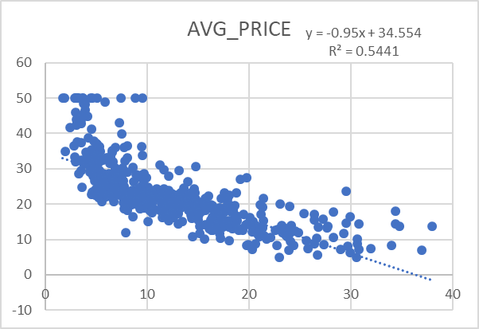
A strong negative relationship between Avg Price and LSTAT
A perfect negative relationship between Avg_price and Lstat can be seen as Y = - 0.95X (a close relationship) with line displaying the decrease in price on the Y-axis with the decrease in the avg_room on the X-axis

Slide 8
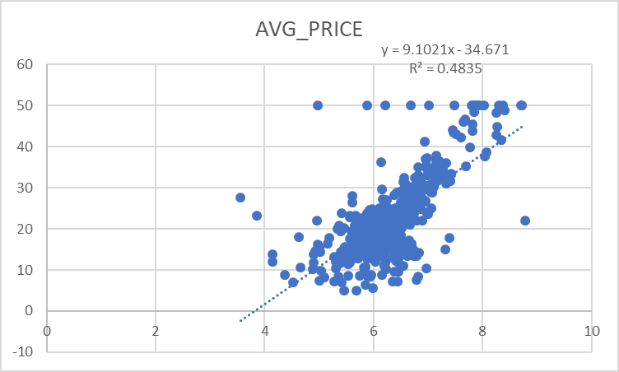
A perfect positive relation between Avg_Price and Avg_Room
A perfect +1 relationship can be seen between the average price and the avg_room, which is visible as Y = 9.1 X. Also, we see a linear line showing a sharp rise between the avg room on the Y-axis and the avg price on the Y-axis

Slide 9
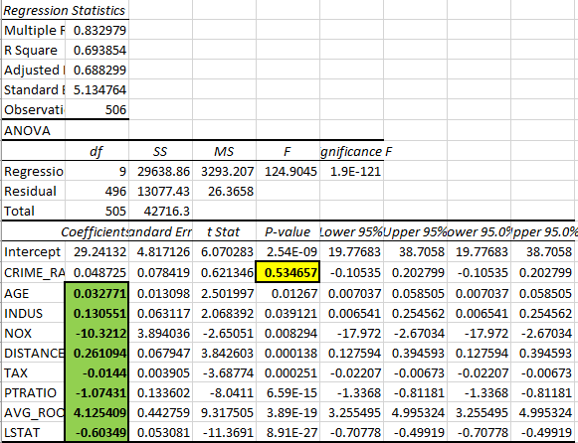
When performing the Regression, we found a Model Fit, which means the adjusted r-square was 69% (close to 70%), the t-stat values too were > 2 and < - 2. Also, the p-values were < 0.05. However, among these, Crime Rate was the only insignificant coefficient holding a p-value > 0.05, so we discarded it for calculating the avg-price

Slide 10
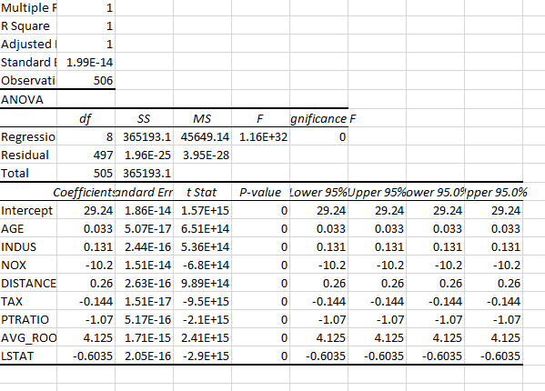
The regression with all the significant variables hold a p-value < 0.05 and t-stat > 2 and < - 2. Also, considering the anomaly here, the adjusted R-square is 1, which means the model is 100% fit

Slide 11
NOX VS New_Avg_Price
A very low relationship, as the graph doesn't display a clear relationship between the sorted (the largest to the smallest) NOX and the new Avg_Price, even the relationship that we can see is Y = -32.32x, which is a far relationship. Besides this, we notice the adjusted R-square is also 0.27 or 27%, which is very less than the model-fit percentage (< 70%), so the model isn't fit when considering the sorted NOX value and the corresponding new average prices

Slide 12
A Thank You Note!
I would like to thank my mentor Mr. Trishanan Das for guiding me in this project!

